Slide 1
The Cloud for Modern Business
Joseph Reynolds
InfoCraft

Slide 2


Joseph Reynolds
Independent Software Consultant InfoCraft.net
North Houston .Net User Group Board Member, 2011 – present
Microsoft C# MVP 2013 – present
Enjoys reading, role-playing games, and spending time with family.
Twitter: @iddjoe
Email: jreynolds@infocraft.net
Github: github.com/jmreynolds

Slide 3
Why the cloud?

Slide 4
Why the cloud?
Rapidly setup environments to drive business priorities
Scale to meet peak demands
Increase daily activities, efficiency and reduced cost.
Speed
Scale
Economics

Slide 5
SaaS Solutions
Differentiation
Agility
Cost
Cloud Infrastructure
Journey to the Cloud
Higher-level services

Slide 6

Leading the journey to the Cloud
Microsoft Enterprise Mobility Suite

Slide 7
Leading the journey to the Cloud
SAAS Solutions
Microsoft Dynamics
Enterprise Mobility
Microsoft Enterprise Mobility Suite
Microsoft Azure
Developer + App Platform
Visual Studio Family + Azure App Service
Data + Analytics
Cortana Analytics Suite
Internet of Things
Azure IoT Suite
Cloud Infrastructure
Azure + Azure Stack + Operations Management Suite

Slide 8

28
Azure regions around the world
Hyper-scale footprint
Latest launch was in October 2015- India – Central, India – South, India – West
GENERALLY AVAILABLE
6 new regions announced: Canada Central, Canada East, Germany Central,
Germany North East, United Kingdom (2 – regions TBD)
More than AWS and Google Cloud combined
Azure regions
Notes:
Azure:
140 Countries
22 Global Regions
AWS:
<15 Countries
12 Global Regions
(but 33 availability zones)

Slide 9
Hyper-scale
Azure
Enterprise proven
Hybrid

Slide 10
Hybrid
Hyper-scale
Enterprise proven
Hybrid
Hybrid
On-premises
Azure Stack

Slide 11




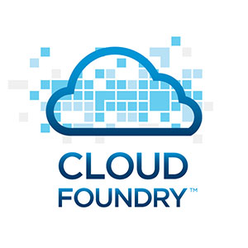
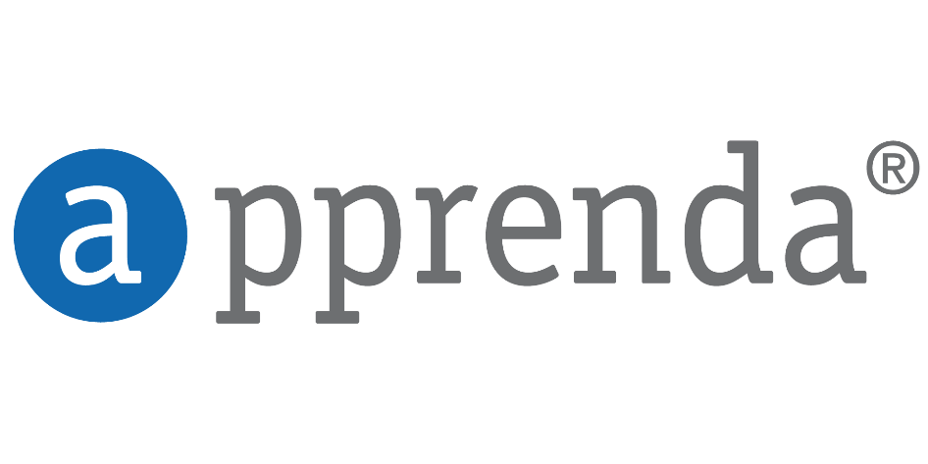















Open + Flexible
Management
Hyper-scale
Open & flexible
Applications
Enterprise proven
App Frameworks
Hybrid
Databases & Middleware
Infrastructure
Linux

Slide 12





Dev + IT productivity
Developer & IT productivity
Visual Studio
GitHub
Eclipse
Chef + Puppet
Powershell
Hyper-scale
Open & flexible
Enterprise proven
Hybrid

Slide 13

SaaS extensibility
Developer & IT productivity
Hyper-scale
Open & flexible
Enterprise proven
Hybrid
Platform for SaaS extensibility

Slide 14


























Trustworthy
More compliance certifications than any other cloud
Developer & IT productivity
Hyper-scale
Open & flexible
Enterprise proven
Trustworthy
Hybrid
Trustworthy
Platform for SaaS extensibility

Slide 15
>90,000
New Azure customer subscriptions/month
>1.5Million
SQL Databases running on Azure
>500Million
Users in Azure Active Directory
Azure momentum
1.5Trillion
Messages per month processed by Azure IoT
777Trillion
Storage Transactions per day
>40%
Revenue from Start-ups and ISVs
Notes:
>85% F500 customers on MS Cloud
>3,400 apps in Azure Marketplace
30 major certifications and attestations — more than any other major public cloud provider
13B authentications supported every week by Azure cloud services
1T messages a month are processed using Event Hub
>60B ingress events per day worldwide in Even Hub
More than 70T storage objects in Azure
More than 9M transactions per second processed by Azure Storage (nearly 3x growth YoY)
1.5M SQL DBs under management in Azure / Customer usage has increased 7x YoY
2.5B logins per week process to Azure SQL DB
External Traffic / web site hits (e.g. customer traffic only)- 83.46 billion hits/month
Total Sites/Apps (customer sites only) – 664k
3.4M Developers registered with Visual Studio Online

Slide 16




























>80% of Fortune 500 use the Microsoft Cloud
Notes:
$1B in Revenue (compared to XX 3 years ago)
Only vendor as a leader in all 4 Gartner Cloud Infrastructure MQ's
>90K new customer subscriptions / month
80% of Fortune 500 customers use MS Cloud (or 58% use Azure)
23 regions announced globally, over 2x the number of AWS regions and 8x Google (3 Regions).
One of the largest networks in the world. We connect to over 1700 networks and have 1.4M miles of fiber in our datacenters
Azure has 22 major certifications and attestations-- more than any other major public cloud provider
Microsoft a Leader in Gartner Magic Quadrants
Cloud Infrastructure as a Service (May 2015)
Application Platform as a Service (March 2015)
Public Cloud Storage Services(June 2015)
X86 Server Virtualization(July 2014)
IDC predicts that 65% of enterprises will commit to hybrid cloud before 2016
Equifax (CPS – US)
details to come from Mark Jewett
Garuda: (Linux – APAC)
Garuda is Indonesia's national airline. They had a locally hosted e-Commerce web application built on open source technologies (PHP, MySQL and Linux Cent-OS Linux) that experienced repeated crashes and security breaches
Azure team stepped in and helped them lift and shift their solution to Azure in two weeks, without the need to re-architect their solution.
68% of the total consumption revenue(~400K) comes from OSS running on Azure
Tax Authority of Mexico (IaaS – LATAM) (SAT)
The Tax Authority of Mexico is the government entity responsible for collecting taxes from 46,3 million taxpayers in Mexico.
The Tax Authority of Mexico (SAT) wanted to upgrade its technology infrastructure to serve the growing demands of 40 million taxpayers who, as a result of changes to local legislation, had to interact electronically with the entity. SAT shifted to the cloud, using Microsoft Azure and other technologies to improve online service levels for citizens and businesses, increase tax control and tax collection, and reduce processing time and tax evasion
SAT wanted to replace its outdated systems and use new IT tools to establish more efficient, modern management processes for increasing tax collection, reducing tax evasion, supporting high data flows, serving hundreds of thousands of employees and taxpayers in simultaneous sessions, and offering those users better service through a simple tax-payment platform.
By using Microsoft Azure, SAT has been able to establish a modern technology environment that offers multiple online services simultaneously to millions of Mexicans, who must make transactions related to tax payment.
SAT works with AWS, IBM, Oracle, and others as part of their multi-vendor strategy. The account team (Raul Flores) having gained the trusted relationship with CIO was able to showcase the power and impact of Azure over other competitive technologies to win this deal

Slide 17
Leading the journey to the Cloud
Microsoft Azure
Developer + App Platform
Visual Studio Family + Azure App Service
Data + Analytics
Cortana Analytics Suite
Internet of Things
Azure IoT Suite
Cloud Infrastructure
Azure + Azure Stack + Operations Management Suite

Slide 18




















Microsoft Azure
Cloud Infrastructure
Compute
Security + Management
Networking
Hybrid Operations
Developer + App Platform
Visual Studio Family + Azure App Service
Virtual Machines
Active Directory
Express Route
Azure AD Connect Health
Containers
Multi-Factor Auth
Virtual Network
AD Privileged Identity Mgmt
Data + Analytics
Cortana Analytics Suite
Remote App
Automation
Load Balancer
Backup
Batch
Key Vault
DNS
Operational Insights
Internet of Things
Azure IoT Suite
Storage
Traffic Manager
Import/Export
Blob Storage
Azure Files
Premium Storage
VPN Gateway
StorSimple
Cloud Infrastructure
Azure + Azure Stack + Operations Management Suite
Application Gateway
Site Recovery
Notes:
In the past we talked about
IaaS
Paas
SaaS
Now, those lines are much more blurred.
What is Hadoop? A Platform (data analytics?) or Software (a software package?)
Instead, Azure breaks it down a bit more.

Slide 19
Virtual Machines
Getting started
Select image and VM size
New disk persisted in storage
Management portal
Windows Server
Boot VM from new disk
>_
Linux
Scripting
(Windows, Linux and Mac)
Blob Storage
General Purpose
Basic
Standard
Optimized Compute
Performance Optimized
Network Optimized
REST API
Cloud
Comprehensive
Networking
Notes:
This is a GREAT way to get started with learning Azure
I use VMs all the time
Trying out new versions of VS
Trying new versions of Windows
Etc
I almost never use VMs for production Azure code.
Why would I? Azure is much better than I am at scaling my servers than I am. As soon as I spin up a VM, I am incurring the headache that Azure solves.

Slide 20
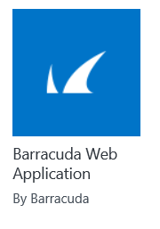
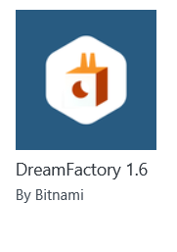
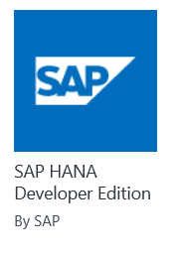
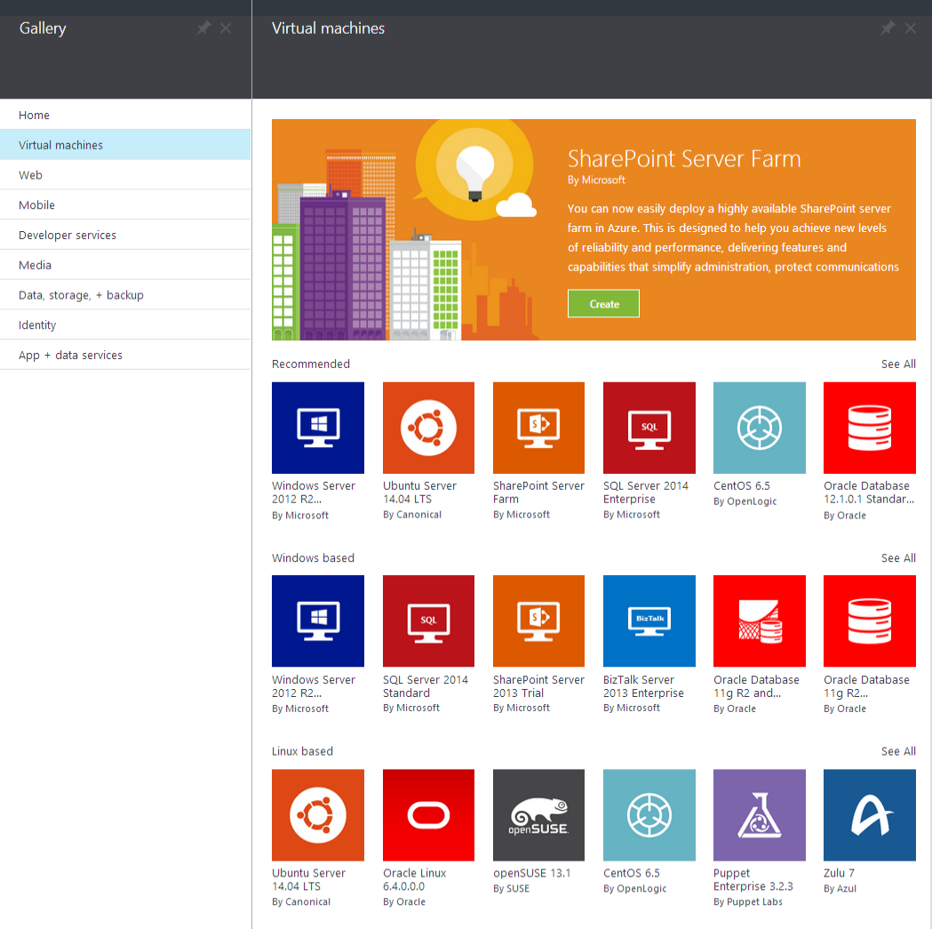

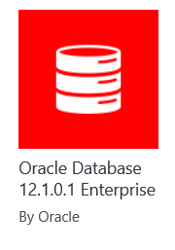
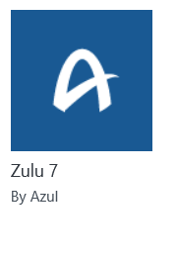
Microsoft Azure
Certified

Slide 21
Demo: Azure Portal

Slide 22

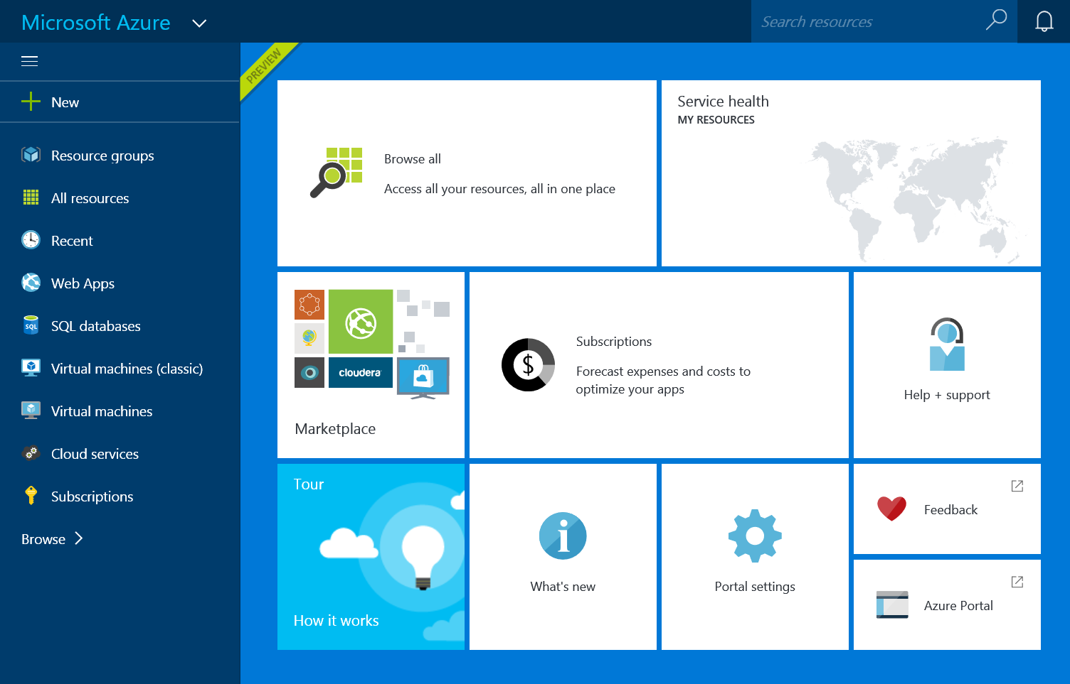
Great Infrastructure Enhancements
G
End to End Management
Premium Storage
Largest VMs in Public Cloud
Integrated management portal
Application Templates
Lifecycle Management
Role Based Access Control
Billing API
Up to 64 TB of storage per VM
>80,000 IOPS per VM
Less than 1ms read latency
Optimized for data workloads
Up to 32 CPU cores, 450 GB RAM, 6.5 TB local SSD
Latest generation Intel processor

Slide 23

Titanfall
→ Game sessions hosted using Azure
→ Hosted using >100,000 Azure Virtual Machines
Notes:
Points to land:
Imagine what you could do…
→ 360,000 concurrent cores
→ Have EA tell the story
→ Assume we don't run out of capacity

Slide 24
New N family of virtual machines
Announcing
N
Latest NVIDIA GPU
Superfast RDMA network
High-end remote visualization

Slide 25

Microsoft Azure Site Recovery Orchestrated disaster recovery to a second site or to Azure
Microsoft Azure Site Recovery
Microsoft Azure Site Recovery
Communication Channel
Communication and Replication
Replication channel: Hyper-V Replica
Windows Server
Primary Site
Recovery Site
Windows Server
Primary Site
Windows Server
Automated VM protection and replication
Remote health monitoring
Customizable recovery plans
No-impact recovery plan testing
Orchestrated recovery when needed

Slide 26












Microsoft Azure
Leading the journey to the Cloud
Developer + App Platform
App Platform Services
Integration
Development Tools
Media & CDN
SAAS Solutions
Microsoft Dynamics
Content Delivery Network
App Service
Storage Queues
Visual Studio
Microsoft Azure
Notification Hubs
BizTalk Services
Visual Studio Online
Media Services
Enterprise Mobility
Microsoft Enterprise Mobility Suite
Developer + App Platform
Visual Studio Family + Azure App Service
API Management
Hybrid Connections
Application Insights
Cortana Analytics Suite
Data + Analytics
Service Fabric
Service Bus
Azure SDK
Cloud Services
Internet of Things
Azure IoT Suite
Cloud Infrastructure
Azure + Azure Stack + Operations Management Suite

Slide 27
Agility

Slide 28
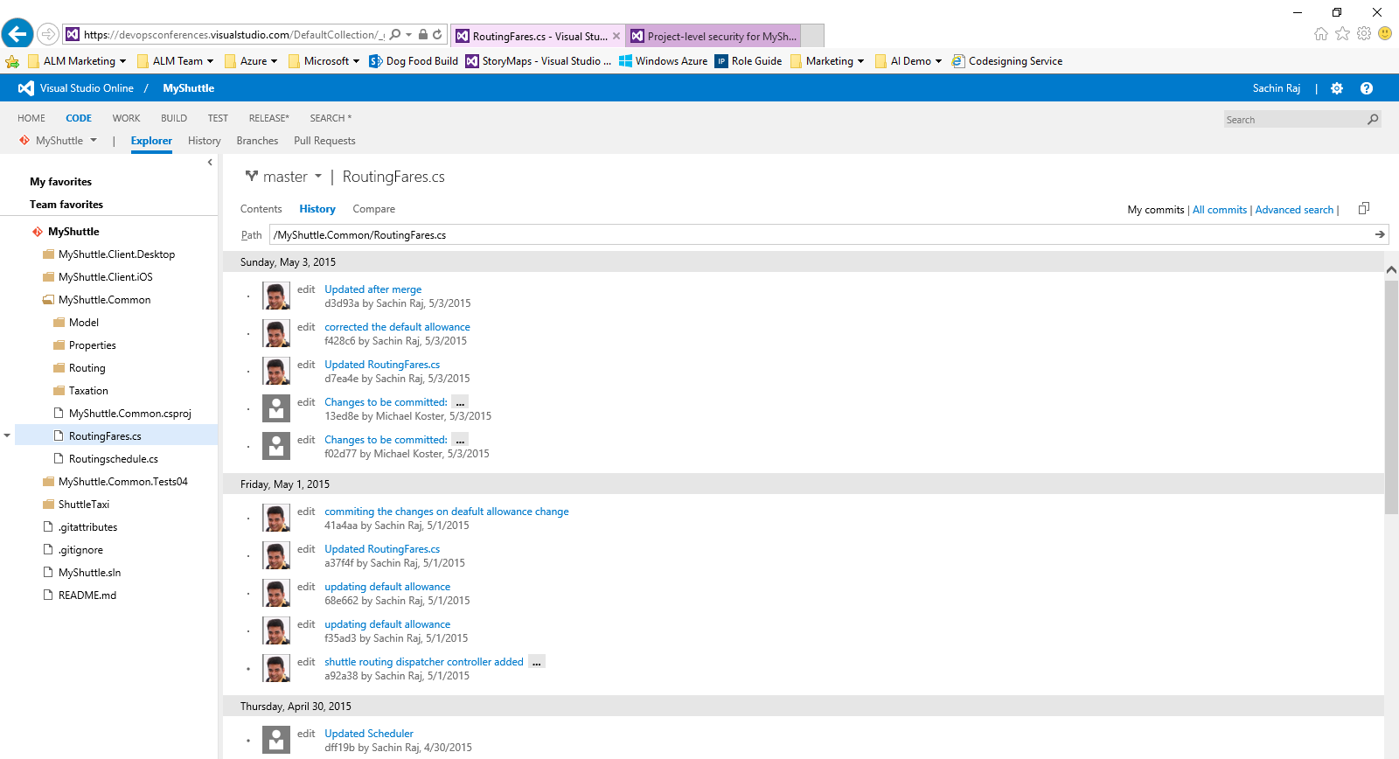
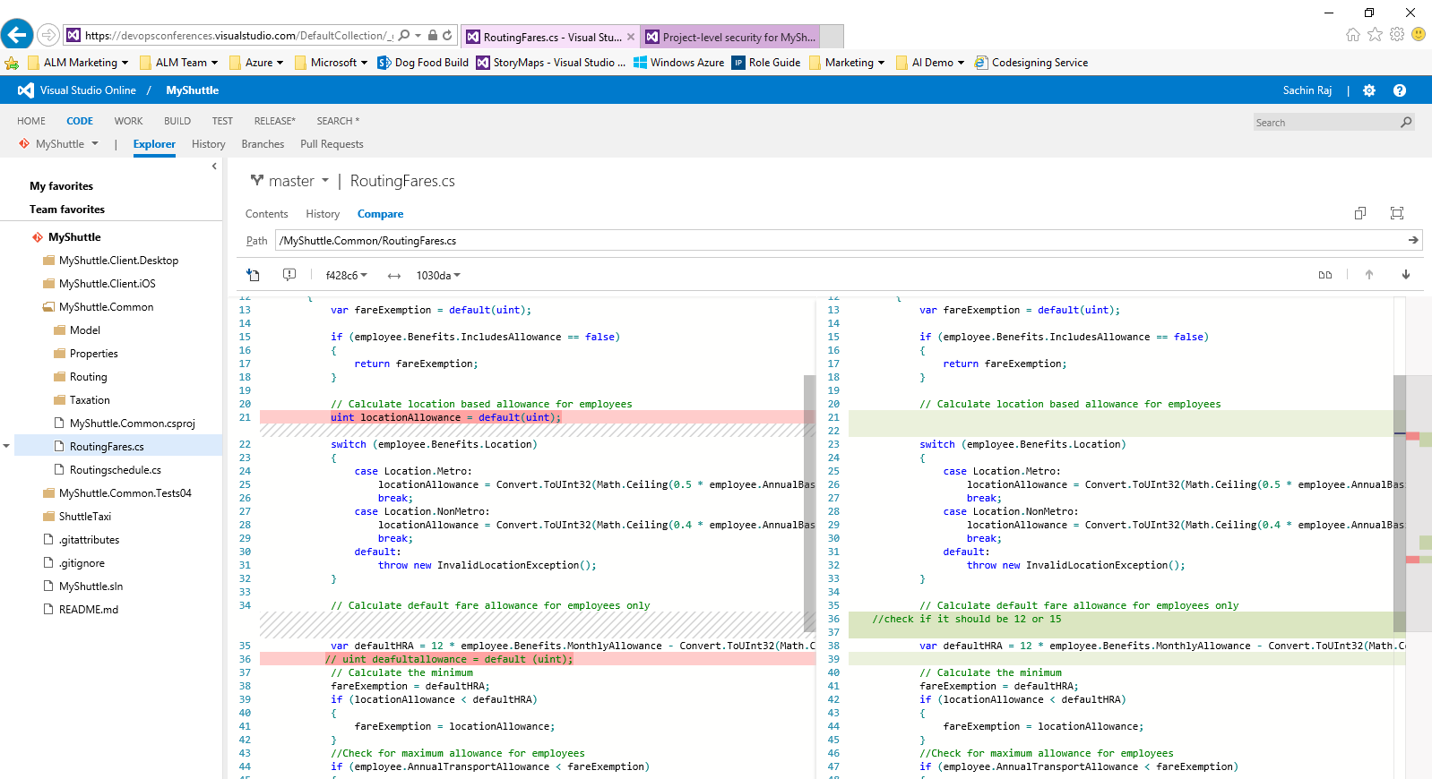
Visual Studio Online
Visual Studio Online: Code Repository
Code Repository
Build + Deploy
Load Testing
Release Management
Azure
Visual Studio
Eclipse / XCode
Application Insights and Hockey App

Slide 29
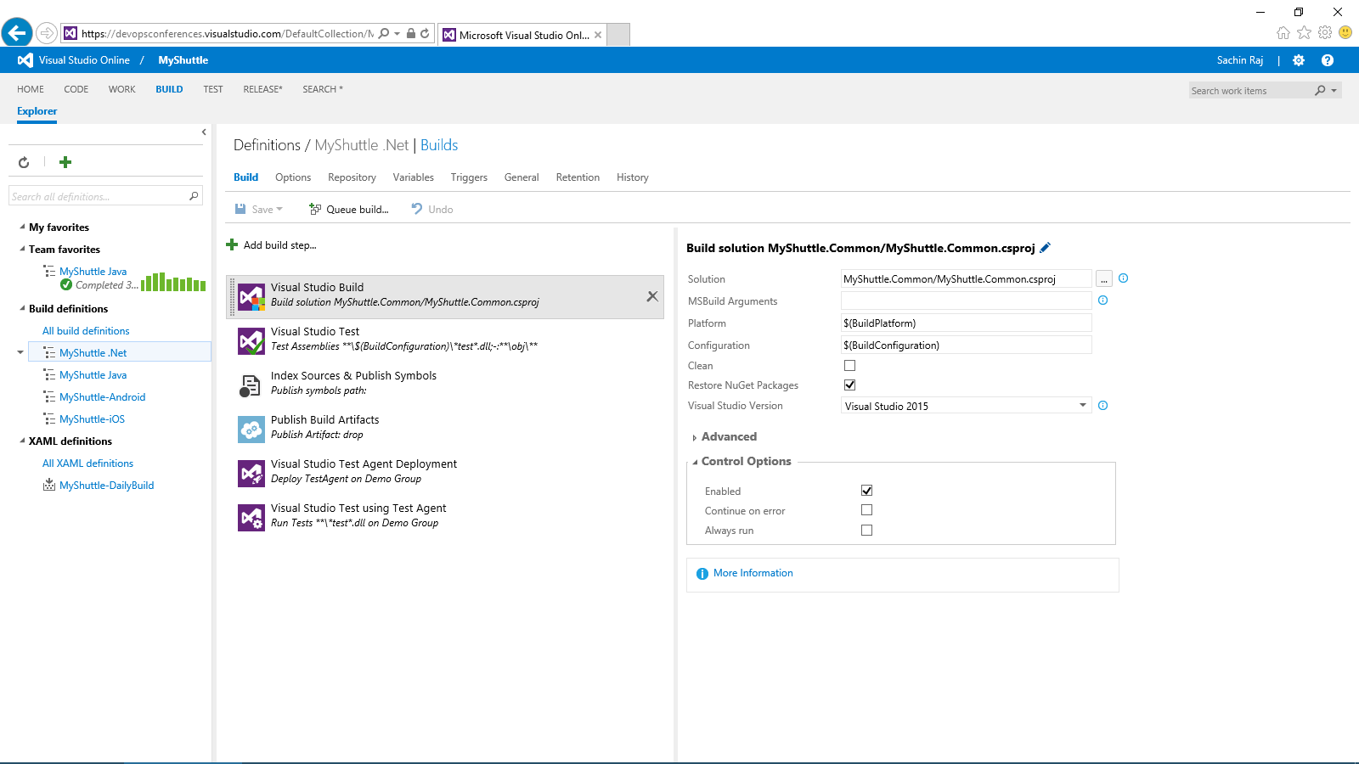
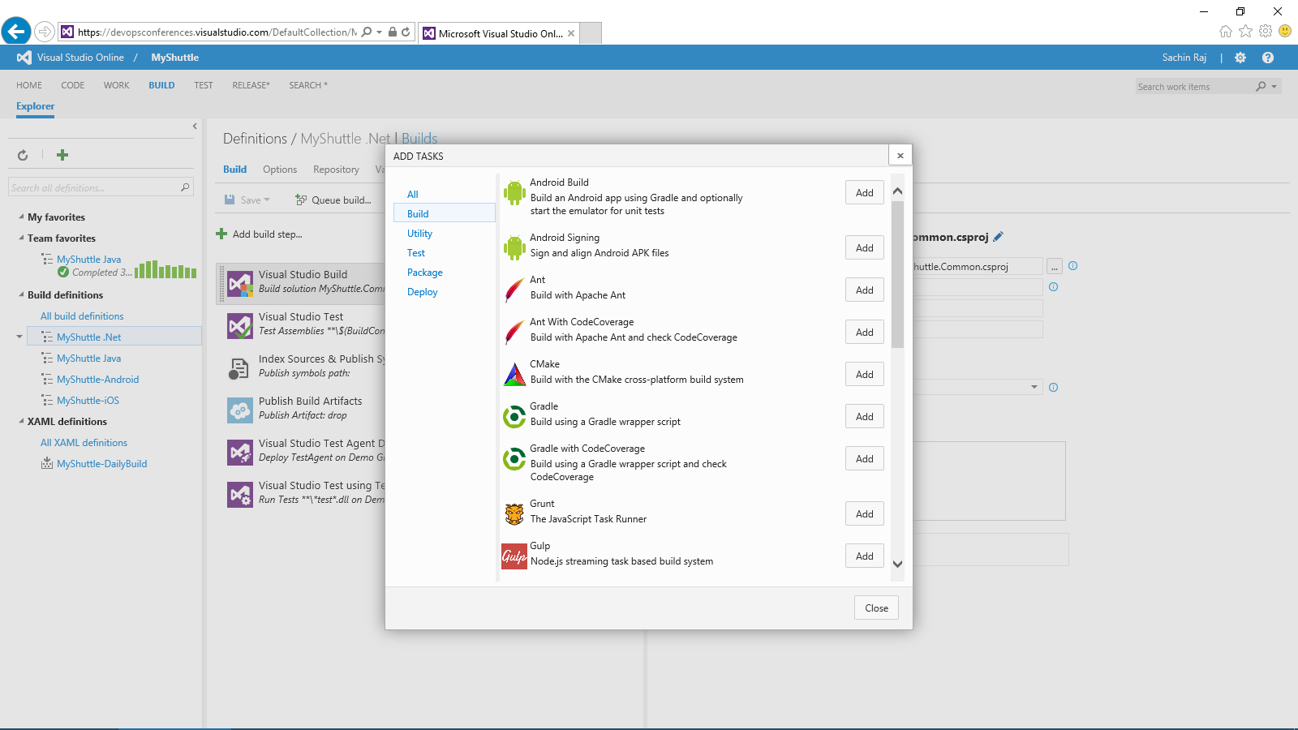
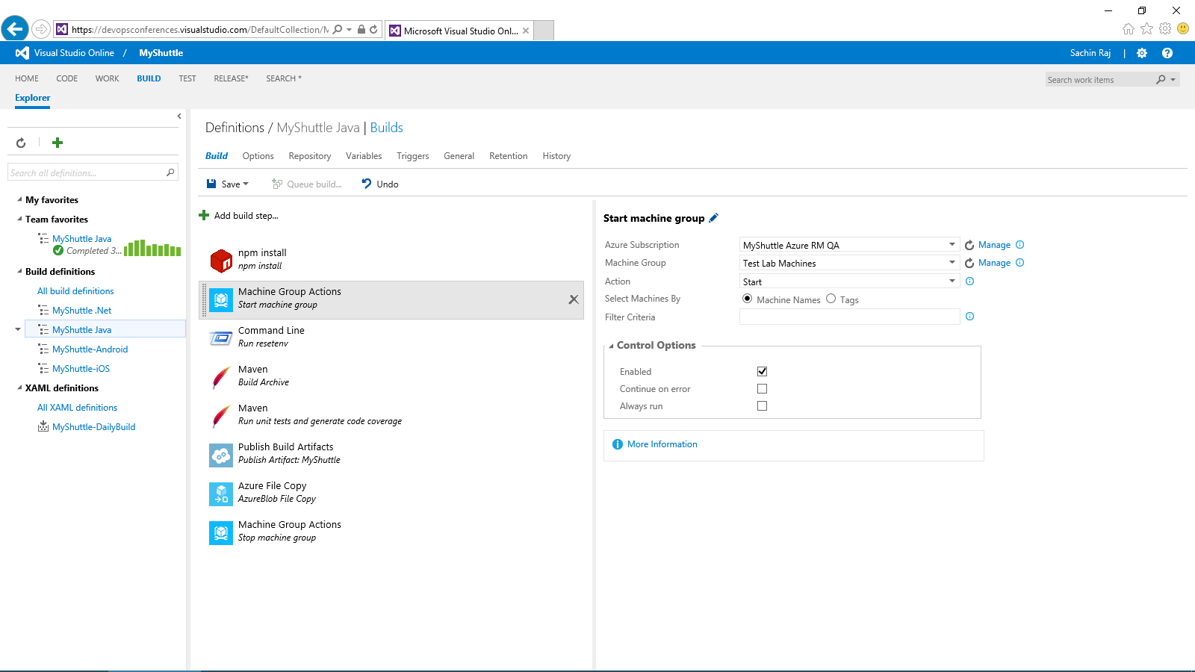
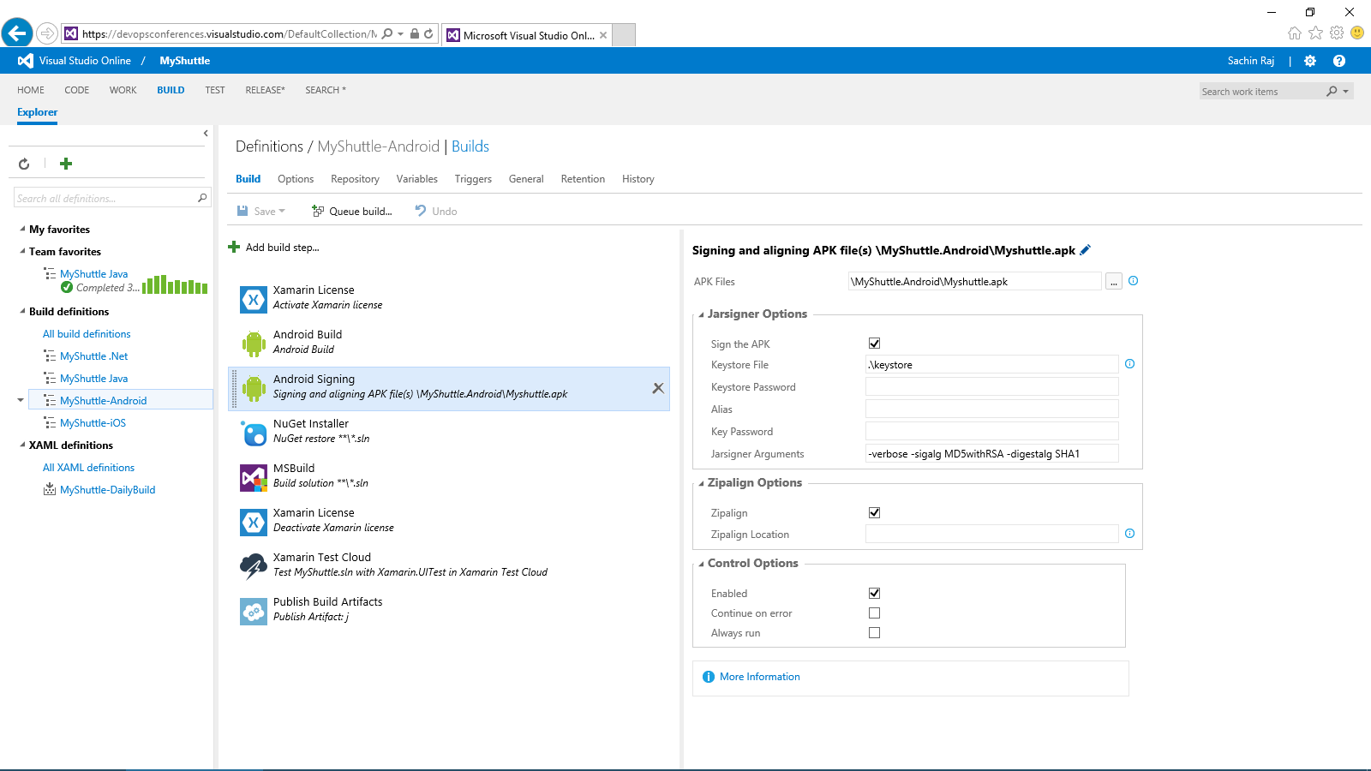
Visual Studio Online: Build + Deploy
Code Repository
Build + Deploy
Load Testing
Release Management
Azure
Visual Studio
Eclipse / XCode
Application Insights and Hockey App

Slide 30
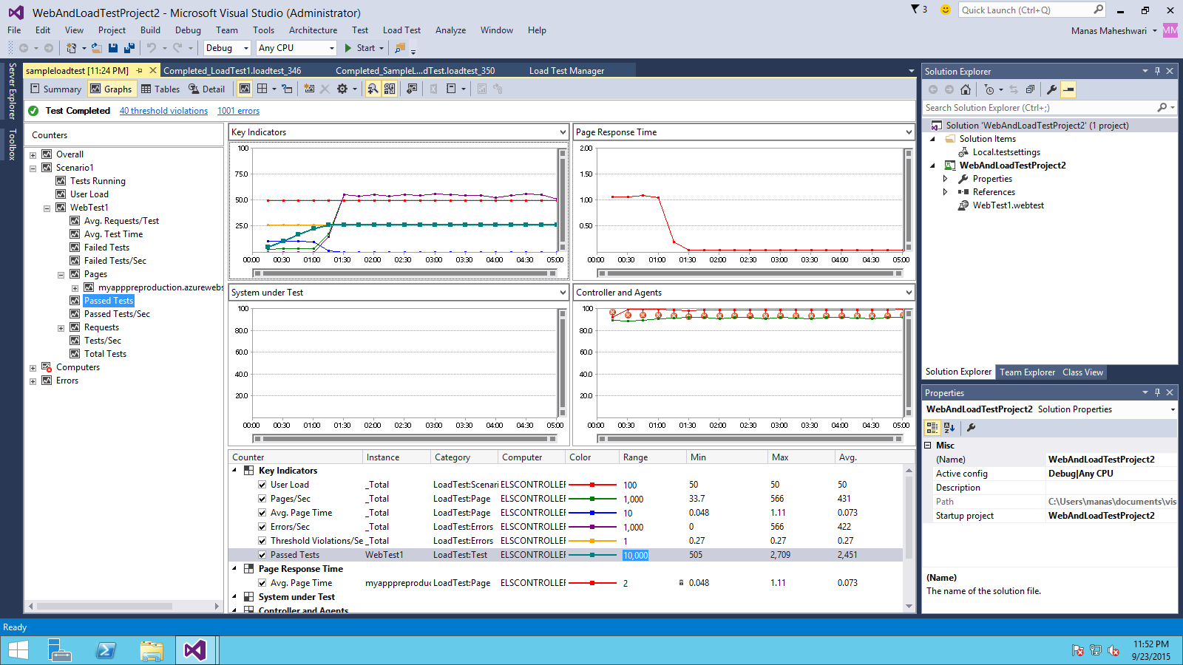
Visual Studio Online: Load Testing
Code Repository
Build + Deploy
Load Testing
Release Management
Azure
Visual Studio
Eclipse / XCode
Application Insights and Hockey App

Slide 31
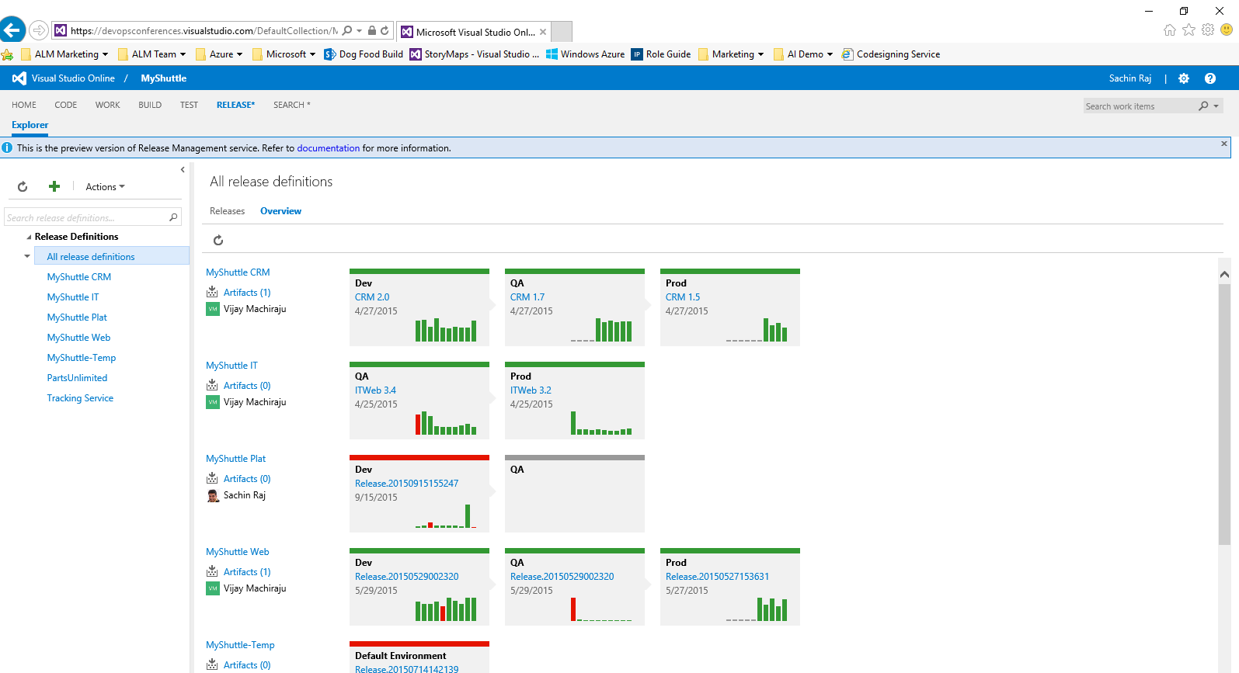
Visual Studio Online: Release Management
Code Repository
Build + Deploy
Load Testing
Release Management
Azure
Visual Studio
Eclipse / XCode
Application Insights and Hockey App

Slide 32
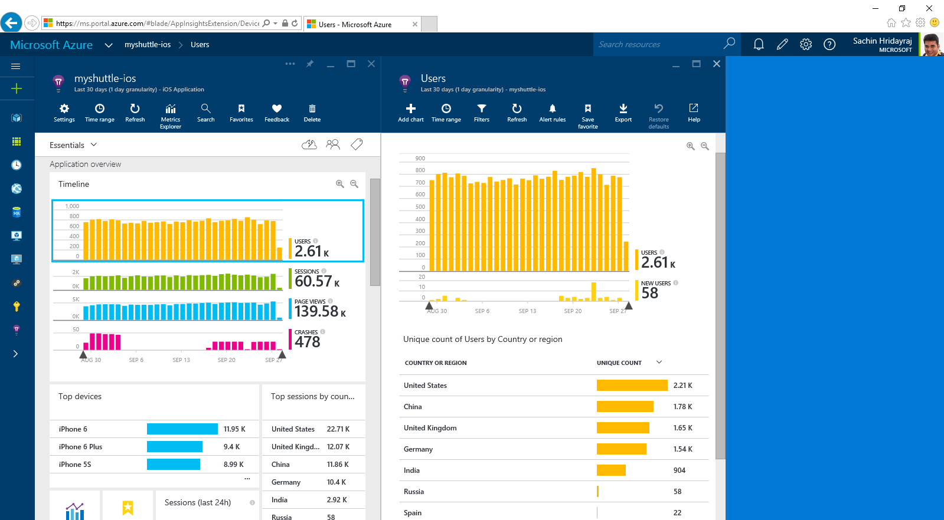
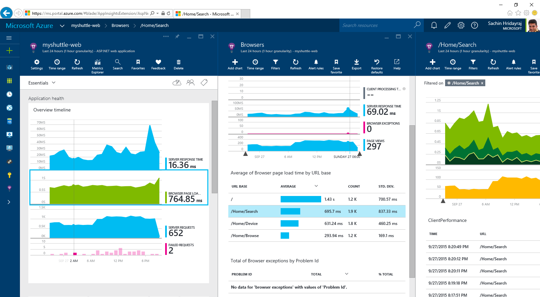
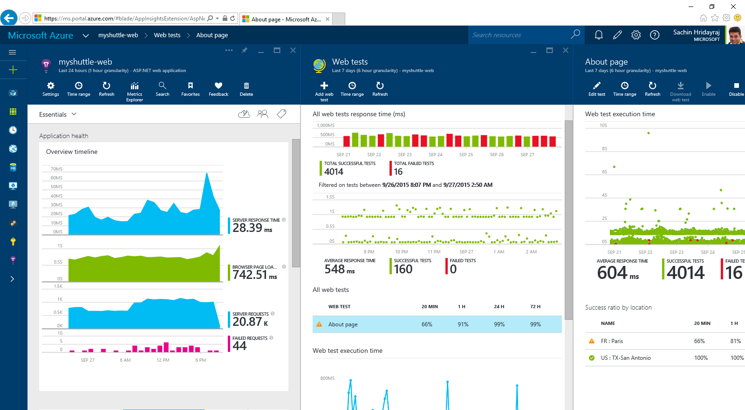
Visual Studio Online: Application Insights
Code Repository
Build + Deploy
Load Testing
Release Management
Azure
Visual Studio
Eclipse / XCode
Application Insights and Hockey App

Slide 33
Visual Studio Online: DevOps
Code Repository
Build + Deploy
Load Testing
Release Management
Azure
Visual Studio
Eclipse / XCode
Application Insights and Hockey App

Slide 34


Azure App Service Build and scale great cloud apps
Web Apps
Mobile Apps
Logic Apps
API Apps
.NET, Java, Node.js, PHP, Python
Auto patching
Auto scale
Integration with existing apps
Continuous deployment
Notes:
App Service has everything you need to build apps that target both web and mobile clients from a single app back-end.
Using API Apps, you can connect your app to dozens of popular services like Office 365 and salesforce.com in minutes, and integrate your own APIs so they can be used within any app.
And finally with Logic Apps, you can automate business processes using a simple no-code experience.

Slide 35
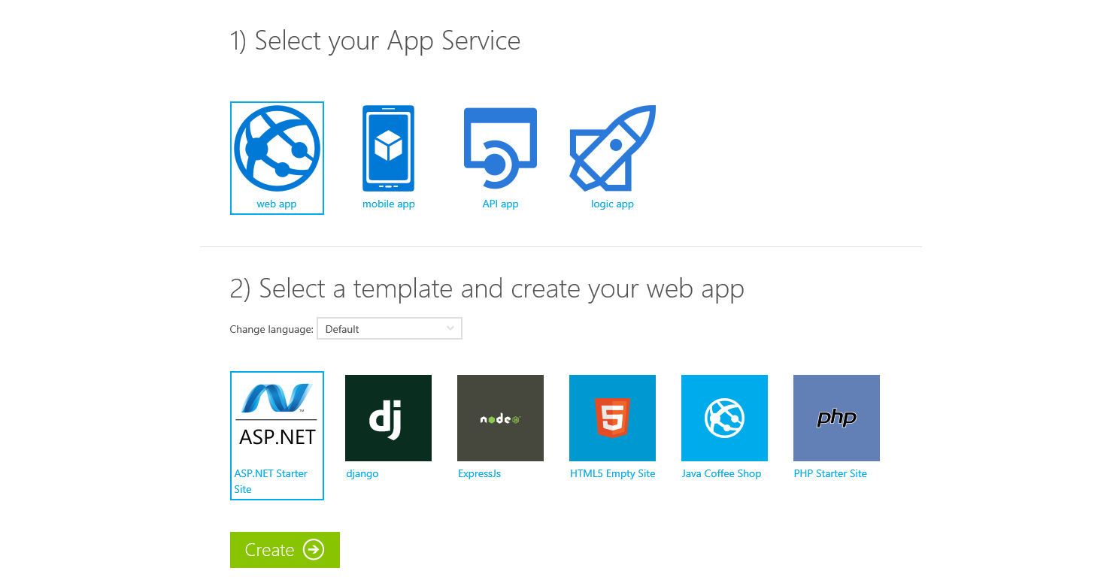
Try App Service Today
https://tryappservice.azure.com
Free
No Signup or Account Required

Slide 36



Azure App Service Web Apps
Start simple
Code smart
Go live
Easily create and scale your new sites in seconds
Automatically scale your sites that scale with your business
Quickly improve performance and reduce latency with right resources
Built-in web jobs support
Leverage existing skills – Languages and databases you know
Start with open source apps and frameworks
Develop with VS and WebMatrix
Supports X-Plat development
Improve developer productivity through continuous automated deployment
Built-in monitoring of perf and usage data
Built-in diagnostics to assist with debugging
Built for DevOps
Office Blog ASP.NET site microsoft.com
Notes:
Speaker notes:
Start simple
Emphasize rapid deployment of Web Apps from choice of Asp.Net starter applications to thousands of pre-built certified, opensource, and community software applications, add-ons, and data analysis platforms pre-configured for Azure.
Explain how Web Apps use automatic load balancing to scale out.
With Web Apps its easy to scale out automatically with increasing instance count using autoscale features e.g. CPU Load, scheduled
Easily improve performance of Web Apps and reduce latency of by changing to right instance size with zero downtime
Supports cron jobs
Code smart
Leverage existing skills to start coding for Web Apps without expensive retraining:
Languages: .NET, Java, NodeJS, PHP, Python. Databases: SQL Server, MySql .
Start coding with any development tools on any platforms such as Linux, OSX and Windows.
Go live
Built for DevOps – Agility through continuous deployment.
Encourages iterative development and improves developer productivity through continuous automated deployment enabled by Web Apps’ integrated source control connectivity to Team Foundation Server(TFS) and Git.
Easily monitor key performance metrics in a verbose or minimal fashion. Easily access monitoring data from a storage account externally for further analysis.
Easily enable diagnostics logging and add instrumentation. Easy access to information logged.

Slide 37
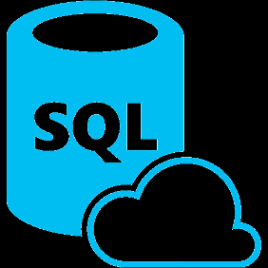






Azure App Service Mobile Apps
Provides essential services to support client development
Client Support
iOS
Android
HTML5/Web
Xamarin
Windows
Windows Phone
PhoneGap
Sencha
Storage
Authentication
Logic
Push
Scheduler
Notes:
Speaking Notes
Azure Mobile Services is a Backend-as-a-Service
Instead of you having to design, build, test, deploy, manage, and upgrade your whole backend, we do it for you
Features of Mobile Services
Storage – SQL DB
Authentication – built in support for social providers w/ ability to custom auth
Backend logic – data validation, logical flows, etc
Push Notifications – across all major mobile platforms
Scheduler – backend job processing

Slide 38










Microsoft Azure
SAAS Solutions
Microsoft Dynamics
Data + Analytics
Data
Analytics
Enterprise Mobility
Microsoft Enterprise Mobility Suite
SQL Database
SQL Data Warehouse
HDInsight
Data Factory
DocumentDB
Data Lake
Machine Learning
Mobile Engagement
Developer + App Platform
Visual Studio Family + Azure App Service
Redis Cache
Tables
Search
Data + Analytics
Cortana Analytics Suite
Internet of Things
Azure IoT Suite
Cloud Infrastructure
Azure + Azure Stack + Operations Management Suite

Slide 39
Intelligent action
What happened?
Why did it happen?
What will happen?
What should I do?

Slide 40
Power BI
Machine Learning
SQL Data Warehouse
HDInsight
Data Lake Analytics
Data Lake Store
Stream Analytics
Data Factory
Data Catalog
Event Hubs
Information management
Big Data stores
Machine Learning
Analytics

Slide 41

Cortana Analytics Suite

Slide 42






Cortana Analytics Suite Transform data into intelligent action
Information Management
Big Data Stores
Machine Learning and Analytics
Dashboards and Visualizations
Business apps
Power BI
Azure
Data Factory
Azure
Machine Learning
Personal Digital Assistant
Azure
Data Lake
Cortana
People
Custom apps
Azure
Data Catalog
Azure
HDInsight (Hadoop)
Perceptual Intelligence
Azure
SQL Data Warehouse
Face, vision
Speech, text
Azure
Event Hub
Azure
Stream Analytics
Business Scenarios
Sensors and devices
Recommendations,
customer churn,
forecasting, etc.
Automated Systems
DATA
INTELLIGENCE
ACTION

Slide 43
SQL Data Warehouse
SQL Data Warehouse
Aggregate + store petabytes of data
Interactively query and visualize data
Operationalize machine learning

Slide 44

Microsoft Azure
SAAS Solutions
Microsoft Dynamics
Enterprise Mobility
Microsoft Enterprise Mobility Suite
Developer + App Platform
Visual Studio Family + Azure App Service
Internet of Things
IoT Hub
Stream Analytics
Logic Apps
Data + Analytics
Cortana Analytics Suite
Internet of Things
Azure IoT Suite
Cloud Infrastructure
Azure + Azure Stack + Operations Management Suite

Slide 45
Things
Now Available to Purchase Azure IoT Suite
Device Connectivity and Security
Data Ingestion and Command & Control
Stream Processing & Predictive Analytics
Workflow Automation
Dashboards and Visualization
Preconfigured Solutions
Notes:
Talking Points:
With Azure IoT Suite we give you a very comprehensive solution that’s designed to help you connect your devices, whether a few hundred or millions across the world, analyze all the data coming from these devices and take action from the insights by integrating with your back end systems. IoT Suite bring together and offer the following capabilities:
Device connectivity and security: Connect to millions of devices simultaneously. Enhance security of your IoT solutions by taking advantage of per-device authentication to communicate with devices that have the appropriate credentials. Revoke access rights to specific devices to maintain the integrity of your system.
Data Ingestion & Command & Control: Establish reliable, bi-directional communication with these assets, even if they are intermittently connected, and analyze—and act on—incoming telemetry data.
Workflow automation: Integrates with your company’s existing back-end systems to enable you to make the best use of the data and processes you already have. Whether it’s as simple as sending a text or integrating with your CRM or EPP system
Dashboards & Visualization: Create powerful and rich visualization experience and finally
Preconfigured solutions: One of the biggest value we can provide is helping you develop IoT solutions faster. This will not only allow you to do more PoCs and pilots, it will also help accelerate the long project cycles we spoke about earlier. We do this by offering preconfigured solutions for the more common IoT scenarios.

Slide 46
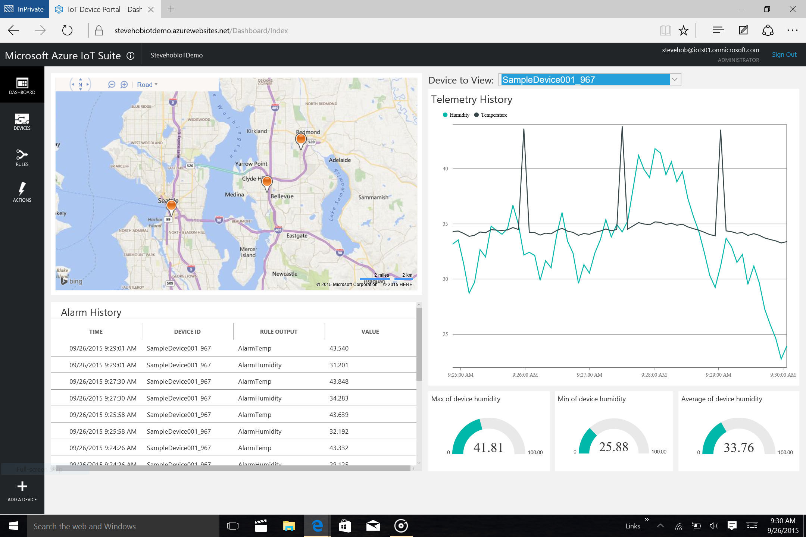
Notes:
Talking Points:
You are taken to a list of devices, where you can ping a device, send a command, turn device on or off, and set threshold for a specific device thru adding rules.
You can also add a device (bottom left corner + sign), and we given you the option to add a virtual device to help you quickly test your hypothesis
Transition: Lets take a look at the rule setting

Slide 47
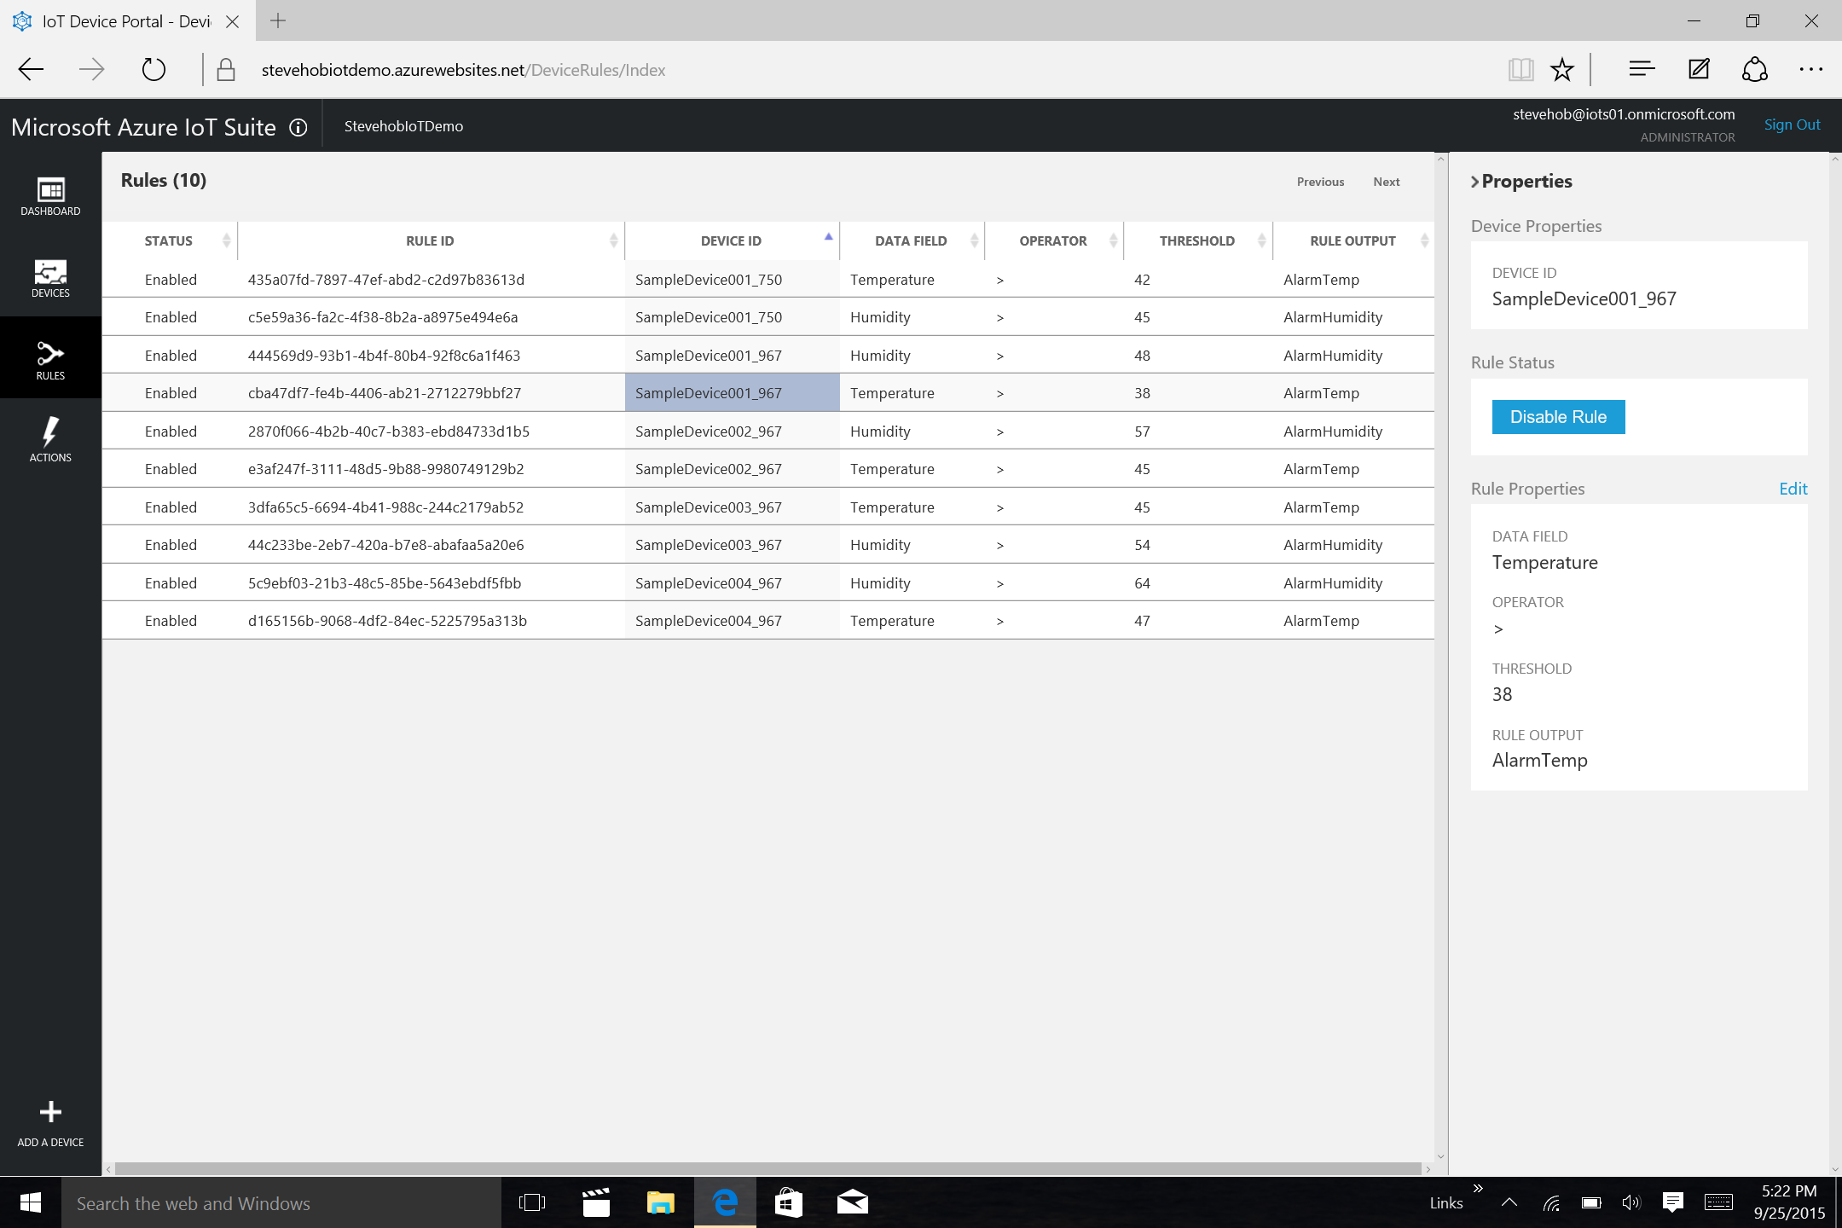
Notes:
Talking Points:
You can set a single or multiple rules to a device based on various data sets.
If you want to set a more complicated rule, so you can go under the hood and directly into event processor service (e.g. stream analytics) in Azure.
Azure IoT Suite is designed to be extensible and can be tailored to your needs.

Slide 48
























Internet of Things

Slide 49
ThyssenKrupp

Slide 50
Delivering secure apps

Slide 51








Announcing Azure Security Center
Gain visibility and control
Integrated security, monitoring, policy management
Built in threat detections and alerts
Works with broad ecosystem of security solutions

Slide 52
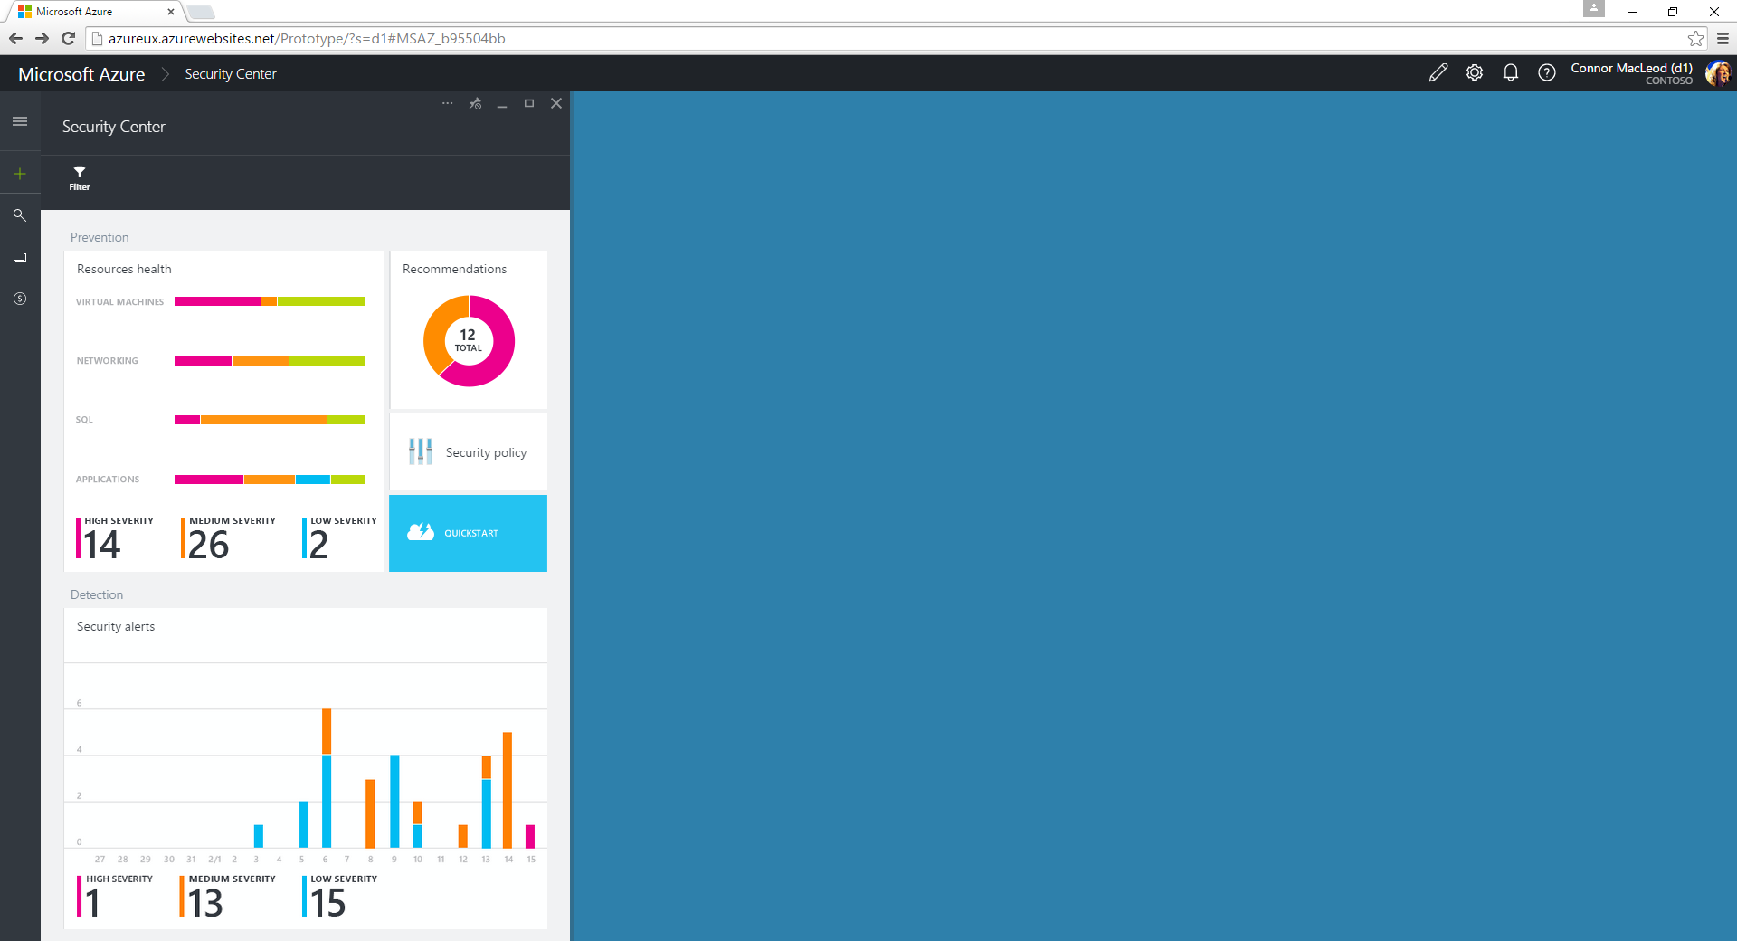
Notes:
The is the main dashboard for Azure Security Center. Here, security admins can get a quick overview of the security state of the organization’s resources across Azure, as well as some high-level information about security alerts and threats detected by Azure Security Center.

Slide 53
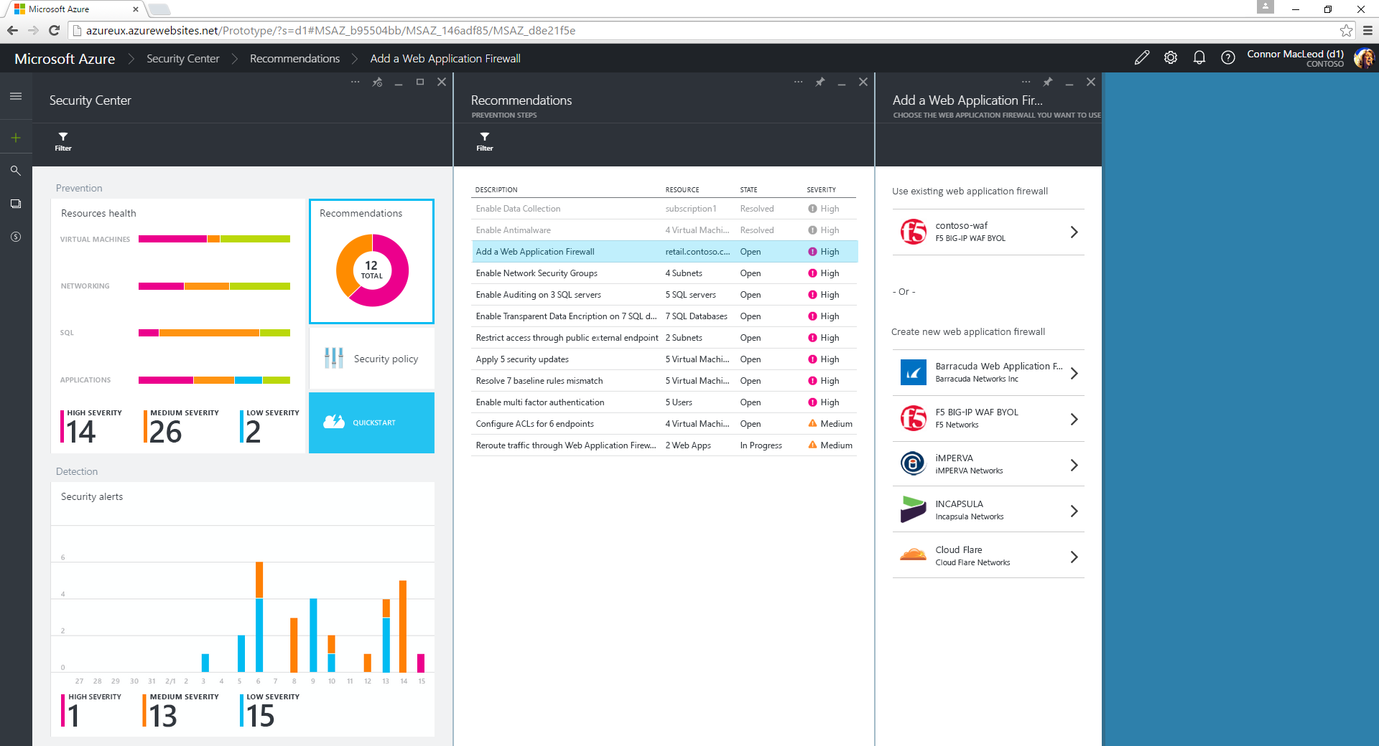
Notes:
Of course, the resource owners themselves can get this information from Azure Security Center without waiting for someone from the security team to tell them about it. This recommendations blade is designed to make it easy for a resource owner to learn about, and correct, an issue. From any of these issues, I can get more detailed information and then click through to a workflow that helps me put the right protection or configuration in place. Here, we’re seeing a web app that doesn’t have a web application firewall in front of it. Azure Security Center is guiding me to choose one of our partner WAF solutions, and then would help me get it installed and configured.

Slide 54
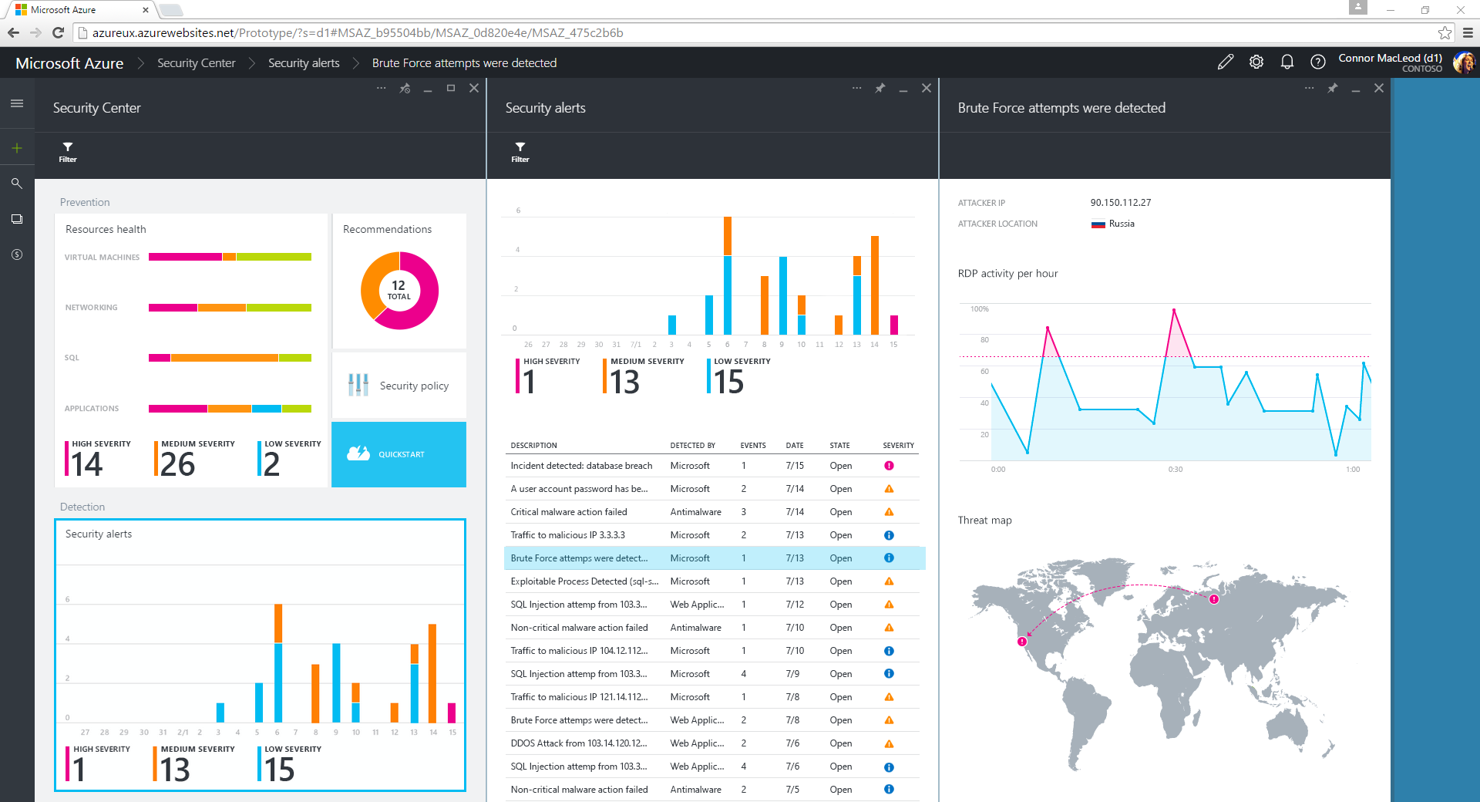
Notes:
Even with the best protection in place, attackers continue to evolve and advance. Azure Security Center helps you keep up with the changing threat landscape by detecting threats as they happen. We do this by applying machine learning to the signals we collect from your deployments; and by comparing those signals with the global threat intelligence we are uniquely positioned to gather by virtue of being one of the biggest players on the internet. Here, you can see a few attacks against this organization’s resources that have been detected by Azure Security Center. For each one, I can click in to get more information, including a recommendation for how to recover.

Slide 55














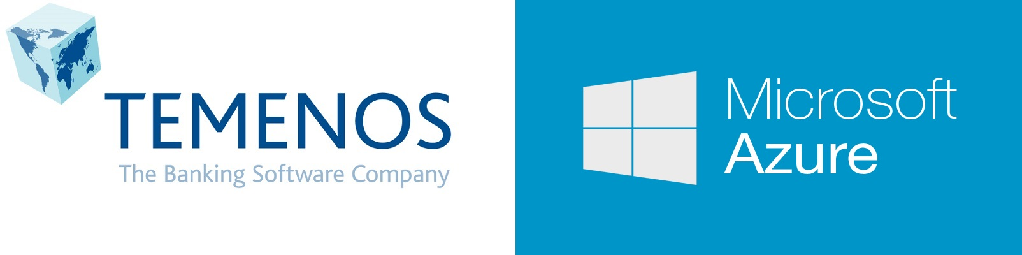










Infrastructure

Slide 56
United Nations

Slide 57
Key Scenarios to Get Started with Microsoft Azure

Slide 58


Key Scenarios to get started with Microsoft Azure
Full Dev/Test environments
Build
Production
Visual Studio Online
Master branch
GIT / TFS
Staging
Check-in
Test branch
Dev/Test
Developers
Notes:
Speaker notes:
Create full Dev, Test, Staging and Production environments in minutes
Availability of Visual Studio Online(VSO) integration with build option available
Validate web app changes in a staging or test deployment slot before swapping it with the production slot
Swap to get your "last known good site" instantaneously if there is a problem with a new deployment in production
Swapping to production from staging as opposed to direct deployment eliminates downtime
Dev, Test, Staging and Production deployment workflow can be automated when pre-swap validation isn’t needed

Slide 59



Key Scenarios to get started with Microsoft Azure
Microsoft SQL Server
VM
Microsoft SQL Server
VM
Microsoft Azure
Lift and Shift
Application VM
Storage
Corporate
Network
Application VM
Archive
key data inexpensively
PDF
JPG
VIDEO
DB
DOCX
Notes:
Speaker notes:
Lift and Shift
Take existing work loads and run them in a certified instance. Emphasize image mobility and Azure Files to help move applications that require SMB shared folders very easily to Azure.
Storage
Archive key data in inexpensive cloud storage. Mention corporate finance databases, industry compliance documents and other key data can be inexpensively archived to Azure storage.

Slide 60

Key Scenarios to get started with Microsoft Azure
HDInsight
Visualization
and reporting
tools
Input
Process
Results
Output
Iterative exploration - Process key data into business intelligence using Hadoop
Notes:
Speaker notes:
Iterative exploration
The source data files(log files, email messages, tweets, and more) are loaded into the cluster, processed by one or more queries within HDInsight, and the output is consumed by the chosen reporting and visualization tools. The cycle repeats using the same data until useful insights have been found, or it becomes clear that there is no useful information available from the data—in which case you might choose to restart the process with a different source dataset.

Slide 61
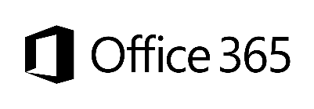










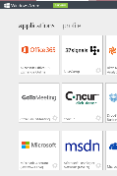
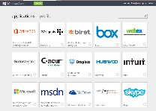

Key Scenarios to get started with Microsoft Azure
Identity as a Service
SaaS
Active Directory
Active Directory
Synchronize and
consolidate
identities
Custom LOB apps
ISV/CSV apps
Azure App Service and Non-MS cloud-based apps
PCs and devices
Notes:
Speaker notes:
Identity as a Service; Control and protect your apps, data and services in Azure together with assets in non-MS cloud using a single AD account.
Consolidate all your identities using one account for single sign-on to any cloud and on-premises services, using your favorite device, including iOS, Mac OS X, Android, and Windows devices.
As a developer you must also need to understand implications of extending your credentials in on-premises Active Directory to Azure Active Directory to protect your assets in on-premises and in the cloud.

Slide 62



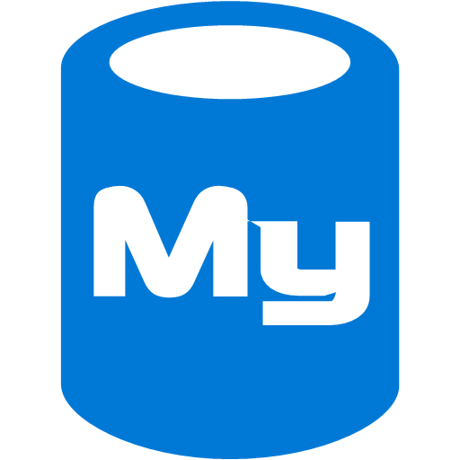



On-premises /
Hosting Services
IIS/SQL Server Based
Web Apps
Microsoft
SQL
Server
IIS
Non-IIS Open Source
Web Apps
Microsoft Azure
MySql
Web Apps - Take your web apps to the cloud using inexpensive App Service Web Apps
Key Scenarios to get started with Microsoft Azure
Notes:
Speaker notes:
You can easily move your existing IIS based web apps including SQL Server databases to Azure App Service easily with a migration tool provided by Microsoft called Azure App Service Migration Assistant.
If your open source web app’s framework is supported on App Service, the languages and frameworks needed by your application are configured for you automatically. Migrate an existing application or create a new one from the Application Gallery.
Consider using Azure Cloud Services or IaaS Virtual Machines if you are unable to migrate your application via Migration Assistant or your open source web app’s framework isn’t supported on App Service.
Other notes:
Windows Server 2003 will reach end of support on July 14th 2015. If you are currently hosting your websites on an IIS server that is Windows Server 2003, Web Apps is a low-risk, low-cost, and low-friction way to keep your websites online, and Web Apps Migration Assistant can help automate the migration process for you.
Moving to Web Apps require less time and IT expertise to configure and secure your apps compared to apps running in VM environment.
Web Apps require no maintenance effort on your part to patch, update, and manage underlying VM environment.

Slide 63
Azure
SQL DB
App Service
Key Scenarios to get started with Microsoft Azure

Slide 64
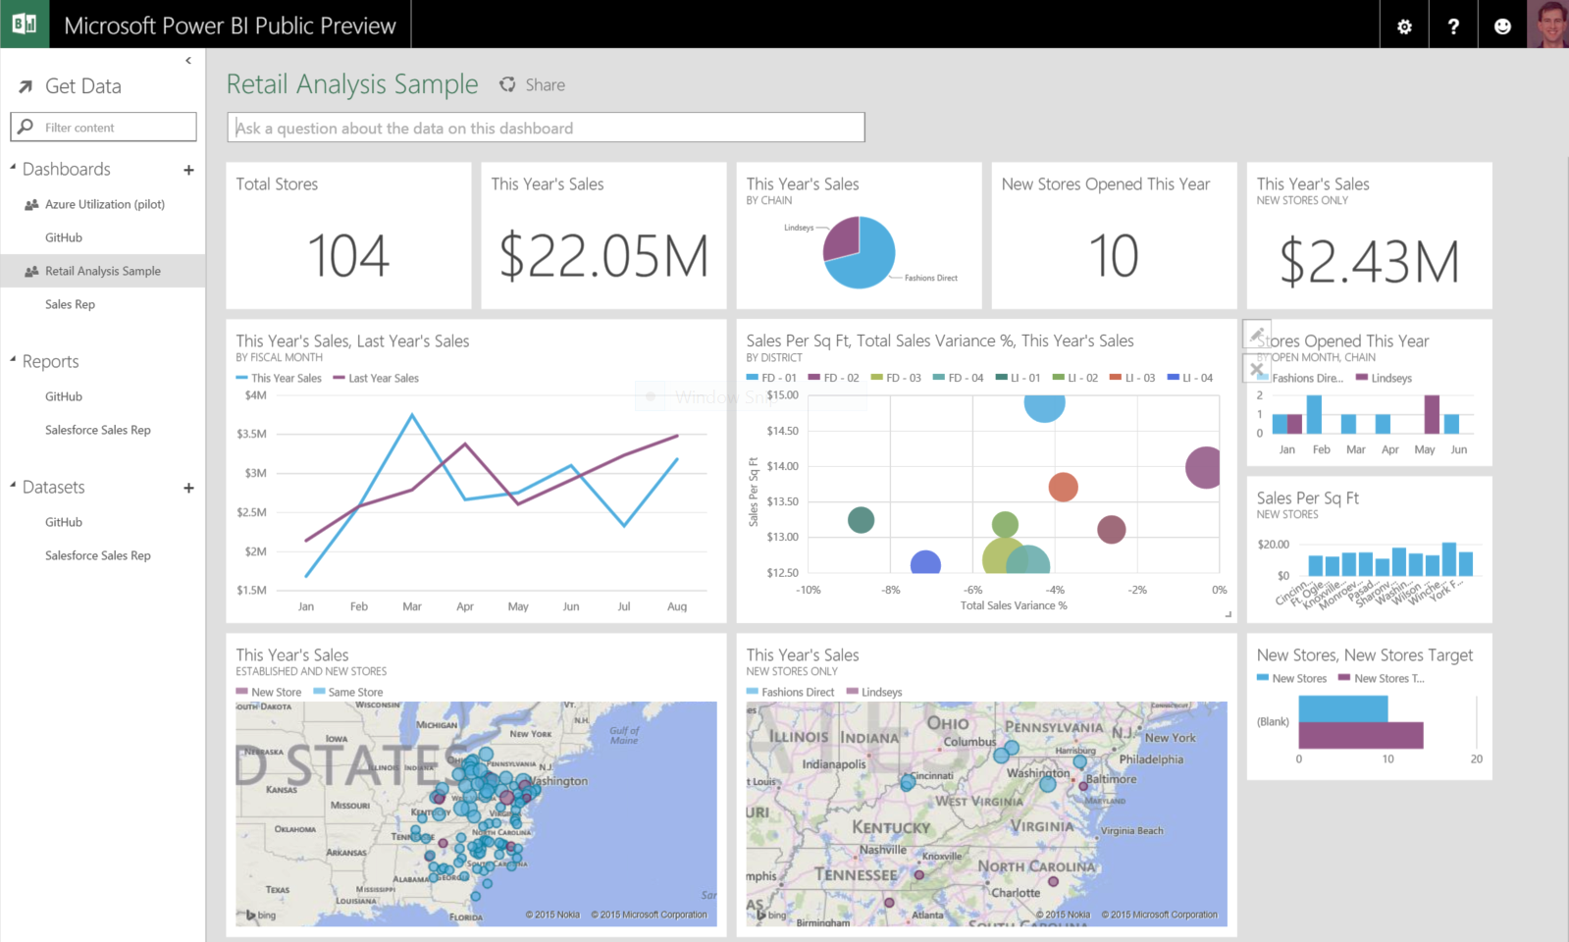
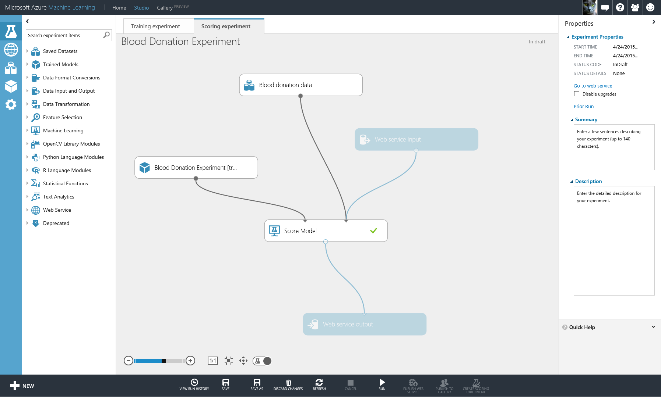

Machine Learning
Reporting
Data Visualization
Hadoop
SQL Data Warehouse
SQL DB
App Service
On-Premises
SAP
Oracle
Dynamics

Slide 65
Hadoop
SQL Data Warehouse
SQL DB
App Service
Intelligent Action
Machine Learning

Slide 66
Activate your MSDN Benefits…
+
3 VMs for 16 hrs a day
80 VMs for 20 hour load test
Up to 100 web sites + DB
Up to
$150
33%^{off}
25%^{off}
89
per Month
Dev/Test VMs
Other Dev/Test
Countries

Slide 67
Get started today at http://azure.microsoft.com

Slide 68
The Cloud is changing the world

